Slide 1

MIXED REALITY
MAMIK DAS
COMPUTER SCIENCE AND ENGINEERING
3rd YEAR
HOOGHLY ENGINEERING AND TECHNOLOGY COLLEGE

Slide 2

DEFINITION
sometimes referred to as hybrid reality.
It is the merging of real and virtual worlds to produce new environments and visualizations where physical and digital objects co-exist and interact in real time.
Mixed reality takes place not only in the physical world or the virtual world.

Slide 3
The faces of MR
Physical Reality (PR) – real world
Virtual Reality (VR) – purely synthetic
Augmented Reality (AR) – virtual assets registered in real world
Augmented Virtuality (AV) – real (people, props) layered in virtual space

Slide 4
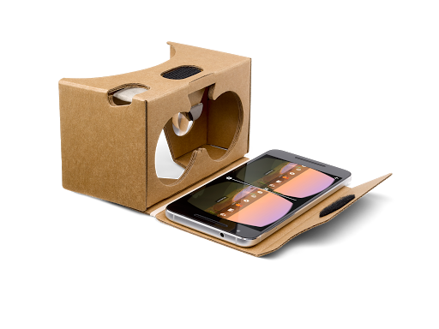
Preview It
SAMPLE VIEWERS
GRAB A GOOGLE CARDBOARD
SCAN THE QR CODE ON THE SIDE OF YOUR PHONE
PLACE YOUR PHONE SCREEN FACING THE CARDBOARD
PUT RUBBER BAND AROUND THE PHONE TO SECURE
CLOSE FLAP WITH VELCRO
VIEW THE VIDEO OR IMAGE-LOOK AROUND YOU.

Slide 5
AR VS VR
AR
Overlay of object around us
Use of phone or viewing device
Usually uses target image
VR
Immersion into another world
Usually uses a head set and a mobile device
Doesn’t interact with real world

Slide 6
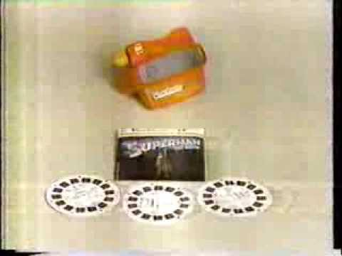
TOOLS OF TRADE
“VR” Blast from the Past
Viewmaster

Slide 7
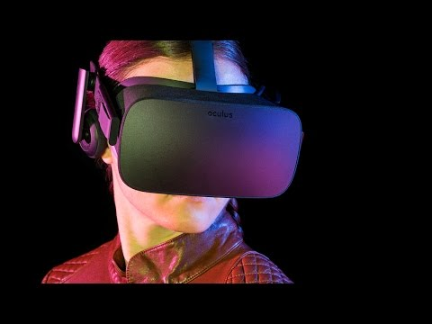
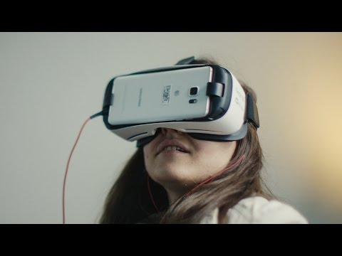
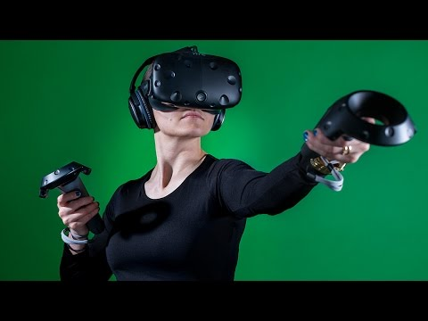

CURRENT VR
Oculus Rift
Samsung Gear
HTC Vive
Google Daydream

Slide 8
Ideas and
Apps

Slide 9
Ideas for the Classroom
Document class trips and virtual tours
Create 3D models for review/tutorial
Immersive stories
Student gallery of work to share
Student created “expeditions”
Walking tour of your community
Writing prompts
Document dissections
“Trigger” walls in the classroom

Slide 10
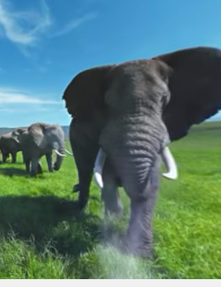
Google Apps
Cardboard
  Cardboard Camera
Street View
Expeditions
Arts and Culture
YouTube: 360 Channels
  Pete’s The Dragon
Place your screenshot here
Create your own for most of these too!

Slide 11
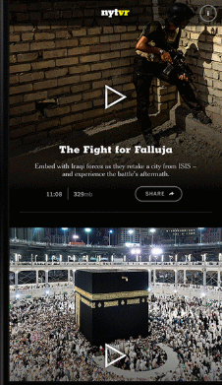
Storytelling and News
NYT VR
Jaunt
Within (formerly VRSE)
Google Spotlight Stories
Huffington Post - RYOT
ABC News
USA Today - Blue Angels, Cuba
Littlstar
Notes:
Nice because they do not require download and can use it on the websites directly or on mobile with app

Slide 12
Social Studies
Apps
360 Web Virtual Tours
You Visit VR
  Cities, college campuses
Virtual speech
  Virtual audiences
VR cities
  Tour of major cities
Timelooper
  Travel back in time through London
Virtual Castles Tour
  Explore global castles
3D History
  Colosseum, WW1, and more
Virtually Anywhere
  Tours of US buildings in D.C.
360 Fullscreen Tours
  Pisa, Mt. St. Helens...

Slide 13
The Arts
Sketchfab VR
  Virtual 3D models
The Rare Book Room
  Read the books online
Tilt Brush (HTC Vive only)
  Virtual drawing in 3D
ThingLink
  Interactive images
Google Arts and Culture
  Explore National Parks
  Artifacts, tours and more
Guggenheim Museum
  Amazing interactive tour
Inside Abbey Road
  Behind the scenes
Indoor Street View
  Tour inside of businesses

Slide 14

Science
VR Apps
AR Apps
Discovery VR
In Mind VR
Mt. St. Helens (web)
Cardio
VR Planetarium
360 Surgery (YouTube)
Anatomy You
Elements 4D
The Brain
Brain scan
Anatomy 4D
Arloon Chemistry $
NASA 3D Spacecraft
Space journey VR/AR
Place your screenshot here
Notes:
All require app download

Slide 15
Math
VR Apps
AR Apps
Agent Cayley
  Algebra based game
Cyberchase Shape Quest
  iPad- Elem. geometry, spatial
Times Table VR
  Multiplication game
Arloon Geometry ($)
  Calculations, spatial vision
Arloon Mental Math ($)
  Rounding, math facts, games
Fetch! Lunch Rush
  Elem. math facts, counting
Photomath
  Solve problems using camera

Slide 16
Augmented Reality
Elementary
AR FlashCards
  Shapes, Space, Addition
Coloring pages that pop
  Quiver
  Crayola Color Alive
  Chromville
Fetch Lunch Rush
  PBS games
Popar Toys
  AR books, charts, puzzles
Spider Friend
  Interact with spiders
WizAR
  Books, flashcards, text
Notes:
Teach Thought’s list

Slide 17
Augmented Reality
Miscellaneous
Enhanced Field Trips
Skin and Bones
  Museum of Natural History
Gardens of Versailles app
  Guided Tour info
National Parks Maps
  Guided Tours, Routes
Google Translate
  Real-time language translation
LearnAR
  Multiple subjects, web based
Wikitude
  Location based information
Notes:
Teach Thought’s list

Slide 18
Create instead of consume
Create your own
VR and AR experiences

Slide 19
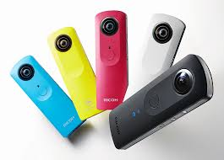
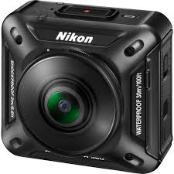
Tools for Creation
Mobile Devices
360 Cameras
Ricoh Theta
Nikon Key Mission 360
Kodak PixPro

Slide 20
Apps for Creation
Google Cardboard Camera - capture 360 images
Google Street View - explore or create photospheres
Aurasma - create target images in under a minute
123D Catch - capture rotatable, 3D objects, 3D printing option
Thinglink VR - annotate 360 images to add audio, video, links
CoSpaces - build interactive VR worlds online

Slide 21
Tools for Integration
Nearpod VR
  Integrated VR lessons
ThingLink VR
  Interactive images
  Sample image 1, 2
CoSpaces
  Build VR worlds
ZSpace
  Apps for education*
Notes:
Core Augmented Reality Ed.

Slide 22
Apps for Creation
Google Cardboard Camera - capture 360 images
Google Street View - explore or create photospheres
Aurasma - create target images in under a minute
123D Catch - capture rotatable, 3D objects, 3D printing option
Thinglink VR - annotate 360 images to add audio, video, links
CoSpaces - build interactive VR worlds online

Slide 23
Resources for VR/AR
41 Ideas using Aurasma
5 Ways to use AR
AR in education blog
AR Writing Prompts
Brainspace Magazine
Teachers Pay Teachers
100 Virtual Tours
VR Scout News
VR in Education
Kathy Schrock’s Guide to AR
Notes:
https://www.edsurge.com/news/2015-11-02-how-to-transform-your-classroom-with-augmented-reality
http://www.schrockguide.net/augmented-reality.html

Slide 24
Fun Creation Apps
Video Affix - add cool video effects to your videos
Car Finder - create GPS scavenger hunt games
Amikasa - 3D interior design/floor planning

Slide 25
CONCLUSION
The conventionally held view of a Virtual Reality (VR) is the participant-observer is totally immersed in,able to interact with, a completely synthetic world.
Such a world may mimic the properties of some real-world environments, either existing or fictional.
My future work relates interior design with home security using MR and IoT.

Slide 26
BIBLIOGRAPHY
This resource are taken from Google I/O 2017
Held in California.

Slide 27
THANK YOU FOR WATCHING

